Slide 1

File Handling in Python:

Slide 2
Introduction to Files
Files store data permanently on disk.
Python provides built-in functions to handle files.
The os module contains plenty of functions for performing operating system-ish stuff like changing directories and removing files, while os.path helps extract directory names, file names, and extensions from a given path.

Slide 3
Types of Files
1. Text Files (.txt, .csv, .log, etc.)
2. Binary Files (.jpg, .png, .exe, etc.)

Slide 4
The OS module
The os module contains plenty of functions for performing operating system-ish stuff like changing directories and removing files, while os.path helps extract directory names, file names, and extensions from a given path.
>>> print os.path.join(‘maps’,’dungeon12.map’) maps\dungeon12.map # Result when run on Windows
The access(path, mode) function tests to see that the current process has permission to read, write, or execute a given path. The mode parameter can be any combination of os.R_OK (read permission), os.W_OK (write permission), or os.X_OK (execute permission):

Slide 5
>>> os.access(‘/usr/local’,os.R_OK | os.X_OK) 1 # I have read AND execute permissions... >>> os.access(‘/usr/local’,os.W_OK) 0 # ...but not write permissions.
>>> os.path.exists(‘c:\\winnt’) # ‘\\’ to “escape” the slash 1
The inverse of access is os.chmod(path, mode) which lets you set the mode for the given path. The mode parameter is a number created by adding different octal values
os.chmod(‘secretPlans.txt’,0640)

Slide 6
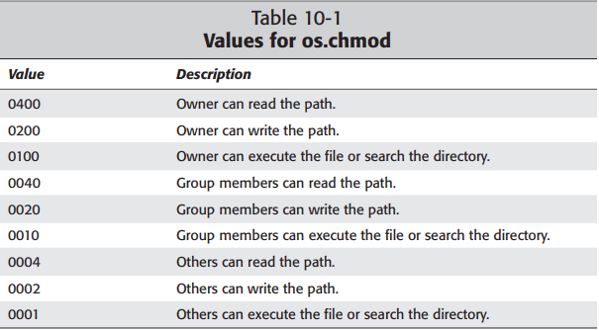
Os.chmod values

Slide 7
Absolute & Relative Path
The os.path.isabs(path) function returns 1 if the given path is an absolute path. On UNIX systems, a path is absolute if it starts with ‘/’; on Windows, paths are absolute if they either start with a backlash or if they start with a drive letter followed by a colon and a backslash:
>>> os.path.isabs(‘c:\\temp’) 1
>>> os.path.isabs(‘temp\\foo’) 0

Slide 8
The following four functions in the os.path module, isdir(path), isfile(path), islink(path), and ismount(path), test what kind of file system entry the given path refers to:
os.path.isdir(‘c:\\winnt’) # Is it a directory?
os.path.isfile(‘c:\\winnt’) # Is it a normal file?
os.path.islink(‘/usr/X11R6/bin/X’) # Is it a symbolic link?
os.path.ismount(‘c:\\’) # It is a mount point?

Slide 9
os.stat()
The os.stat() retrieves several pieces of information about a path.
Eg: file’s size as well as the time it was last modified
The os.stat(path) function solves this problem by returning a tuple with ten pieces of information all at once
os.stat('C:\\Program Files\\Common Files\\Oracle\\Java\\javapath')

Slide 10
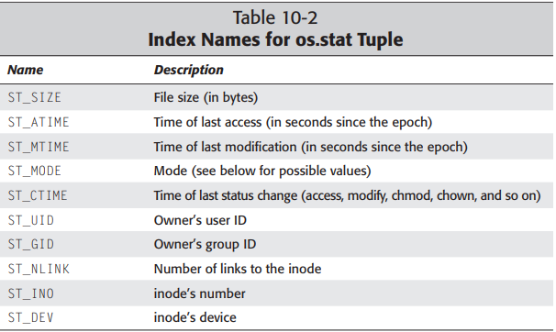
os.stat() values

Slide 11
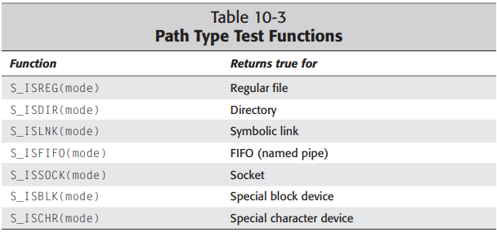
import stat
mode = os.stat('C:\\Program Files\\Common Files\\Oracle\\Java\\javapath')[stat.ST_MODE]
stat.S_ISREG(mode)
False

Slide 12
Listing Directories
The os.listdir(dir) function returns a list containing all the files in the given directory:
os.listdir('c:\\Program Files’)
['Common Files', 'desktop.ini', 'DTU', 'Google', 'IIS', 'Internet Explorer', 'Java', 'KMSpico', 'Mendeley Reference Manager', 'Microsoft', 'Microsoft Help Viewer', 'Microsoft Office', 'Microsoft Office 15', 'Microsoft OneDrive', 'Microsoft SQL Server', 'Microsoft SQL Server Compact Edition', 'Microsoft Sync Framework', 'Microsoft Synchronization Services', 'Microsoft Update Health Tools', 'Microsoft Visual Studio 10.0', 'Microsoft Visual Studio 9.0', 'Microsoft.NET', 'ModifiableWindowsApps', 'Mozilla Firefox', 'MSBuild', 'MySQL', 'nodejs', 'OpenLogic', 'PCHealthCheck', 'Realtek', 'Reference Assemblies', 'RUXIM', 'Synaptics', 'Uninstall Information', 'Windows Defender', 'Windows Defender Advanced Threat Protection', 'Windows Mail', 'Windows Media Player', 'Windows Multimedia Platform', 'Windows NT', 'Windows Photo Viewer', 'Windows Portable Devices', 'Windows Security', 'Windows Sidebar', 'WindowsApps', 'WindowsPowerShell']

Slide 13
The dircache module provides its own listdir function that maintains a cache to increase the performance of repeated calls

Slide 14
Creating and Reading Text Files
Using open() function to create and read files.
Modes: 'r', 'w', 'a', 'r+', 'w+'.

Slide 15
Example: Creating a Text File
file = open('example.txt', 'w')
file.write('Hello, World!')
file.close()

Slide 16
Reading a Text File
file = open('example.txt', 'r')
content = file.read()
print(content)
file.close()

Slide 17
File Methods: Read & Write
read(), readline(), readlines(), write(), writelines().

Slide 18
Example: Reading Methods
file.read() - Reads the entire file.
file.readline() - Reads one line.
file.readlines() - Reads all lines into a list.

Slide 19
Writing to a File
file.write('Appending Data')
file.writelines(['Line1', 'Line2'])

Slide 20
Appending Data to a File
file = open('example.txt', 'a')
file.write('\nNew Line')
file.close()

Slide 21
Working with Binary Files
Binary files store data in binary format, e.g., images, executables.

Slide 22
Reading and Writing Binary Files
Use 'rb' and 'wb' modes to read/write binary files.

Slide 23
Example: Writing Binary Data
file = open('image.jpg', 'rb')
data = file.read()
file.close()

Slide 24
Example: Copying Binary Files
with open('source.jpg', 'rb') as src, open('copy.jpg', 'wb') as dst:
dst.write(src.read())

Slide 25
The Pickle Module
Used to serialize and deserialize Python objects into binary format.
Any object in Python can be pickled so that it can be saved on disk.
What Pickle does is it “serializes” the object first before writing it to a file. Pickling is a way to convert a Python object (list, dictionary, etc.) into a character stream.
It provides a facility to convert any Python object to a byte stream. This Byte stream contains all essential information about the object so that it can be reconstructed, or “unpickled” and get back into its original form in any Python.

Slide 26
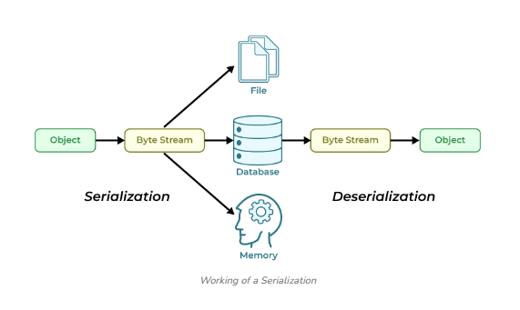

Slide 27
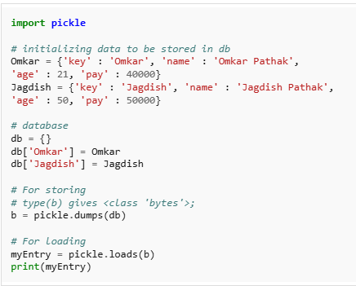

Slide 28
Advantages of Pickel
Object sharing (references to the same object in different places): This is similar to self-referencing objects. Pickle stores the object once, and ensures that all other references point to the master copy. Shared objects remain shared, which can be very important for mutable objects.
Recursive objects (objects containing references to themselves): Pickle keeps track of the objects it has already serialized, so later references to the same object won’t be serialized again

Slide 29
Example: Pickle Serialization
import pickle
data = {'a': 1, 'b': 2}
with open('data.pkl', 'wb') as f:
pickle.dump(data, f)

Slide 30
Example: Pickle Deserialization
with open('data.pkl', 'rb') as f:
data = pickle.load(f)
print(data)

Slide 31
Reading and Writing CSV Files
Use Python’s csv module to work with CSV files.

Slide 32
Example: Writing a CSV File
import csv
with open('data.csv', 'w', newline='') as f:
writer = csv.writer(f)
writer.writerow(['Name', 'Age'])
writer.writerow(['Alice', 25])

Slide 33
Example: Reading a CSV File
with open('data.csv', 'r') as f:
reader = csv.reader(f)
for row in reader:
print(row)

Slide 34
Python os Module
Provides functions to interact with the operating system.

Slide 35
Example: Listing Files in Directory
import os
print(os.listdir('.'))

Slide 36
os.path Module
Used for path manipulations like joining, checking existence.

Slide 37
Example: Path Operations
import os.path
print(os.path.exists('data.csv'))
print(os.path.join('dir', 'file.txt'))

Slide 38
Thank You

